Slide 1
Online Learning System Based on Android
Graduation Design Report
Student Name: Zeya Kong
Student Id:201421092010
Instructor Name: Xinnian Wang

Slide 2
Contents
1. What is online learning system ?
2. Why did I choose this project?
3. How did I implement the core components?
4. The process of real phone showing.

Slide 3
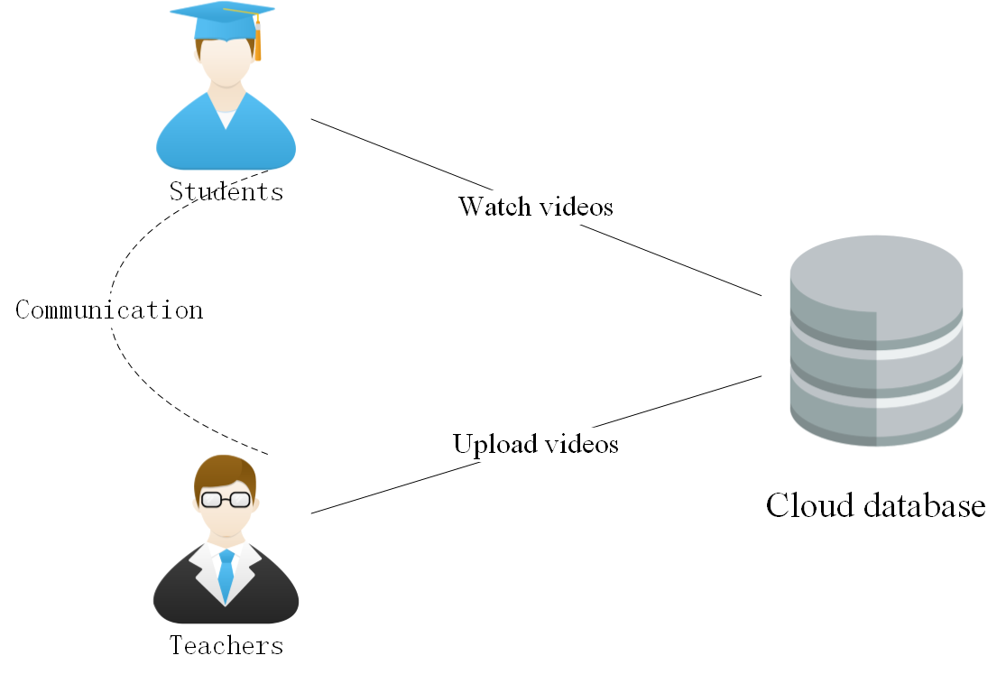
Online Learning System
Core Function

Slide 4
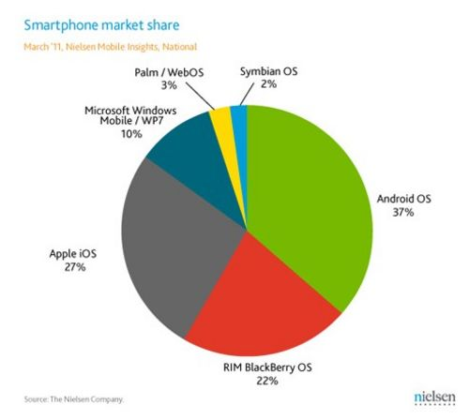
Why did I choose this project?
Android is
Popular.
2. The Hubei Province Teaching Research Fund Project.
3. The Instructor’s Recommend.

Slide 5

Key technology implementation
Cloud Database
Data Storage
Send Phone Message
Payment

Slide 6

Key technology implementation
Material Design

Slide 7
Real Phone Testing

Slide 8
Thanks for your listening!

